Slide 1
BACKDOORING Pickles: A decade only made things worse
ColdwaterQ, Defcon 30

Slide 2
Background
What happened 11 years ago
Marco Slaviero¹ explains how to create malicious Pickles
Pickles are code
Predominately deserialization attacks at the time
1. BlackHat 2011 - "Sour Pickles, A serialized exploitation guide in one part" by Marco Slaviero - YouTube

Slide 3
Background
What’s different today
Pickles are still code
Machine Learning (AI) libraries started to be released using Pickles to save models
Pickles for Models are like Macros for Office Documents

Slide 4
Background
Models?
A combination of layers and weights
Layers are the equation represented as code
Weights are the coefficients which we view as learned data
Pickles are the perfect way to save these because it combines code and data, while ignoring security
Often multiple pickles are stacked in one file to represent a single model

Slide 5
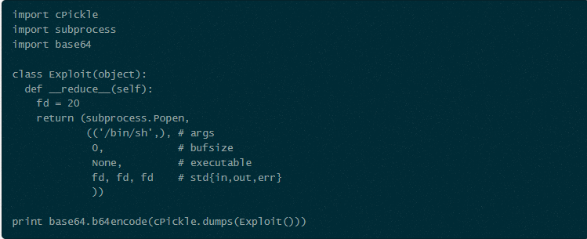
Making a Malicious Pickle
Examples from the Internet
1. https://blog.nelhage.com/2011/03/exploiting-pickle/

Slide 6
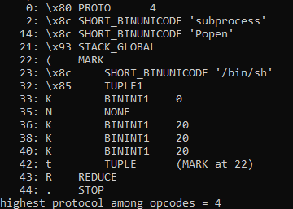
Inspecting Pickles
Disassembly
1
Python’s built in pickletools.dis() produces a disassembly of a pickle
1. Reference to subprocess.Popen added to the stack
2. Mark the beginning of parameters, write them on the stack, and combine them into one reference
3. Reduce the two references to one reference to the result of the function called with the parameters
2
3

Slide 7
Making a Pickle Malicious
Fickling… Awesome, but
Fickling is made by Trail of Bits
It can inject python code into an existing pickle and scan pickles to attempt to detect malice
Issues
More complicated than we require
Can only really inject at the beginning

Slide 8
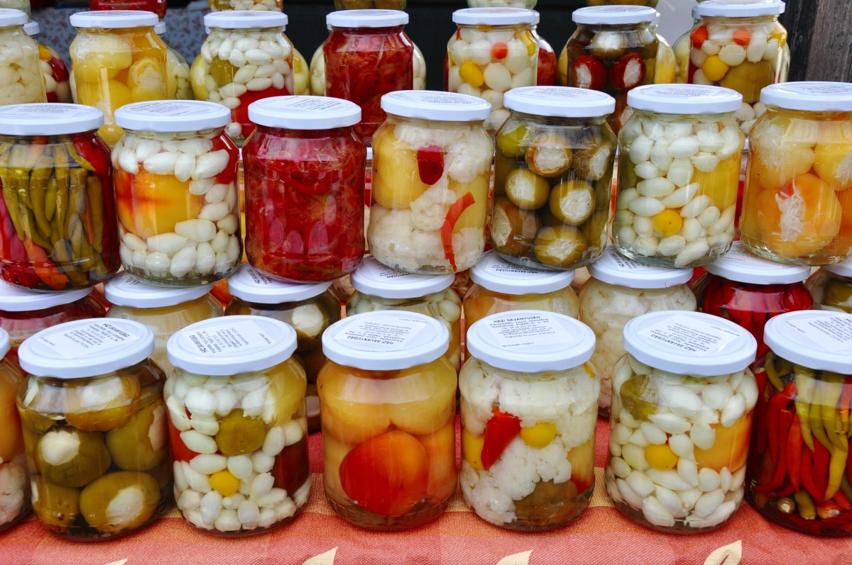
Making a Pickle Malicious
Fickling… More complicated
Symbolic interpreter is safer than loading the pickle
Bugs prevent loading every pickle
Trying to patch this led me down this rabbit hole

Slide 9
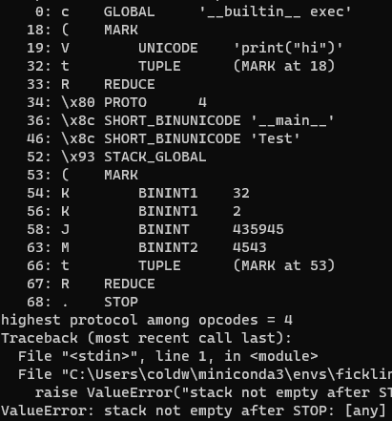
Making a Pickle Malicious
Fickling… Only inject at the Beginning
Fickling’s shell code leaves a pointer on the stack
Would corrupt the result if added anywhere other than the beginning

Slide 10
under The Pickle Hood
What else do you need to Know
Pickle is an instruction set not a file type
No forking or conditional logic
Can import python callables
1. https://github.com/python/cpython/blob/3.10/Lib/pickletools.py

Slide 11
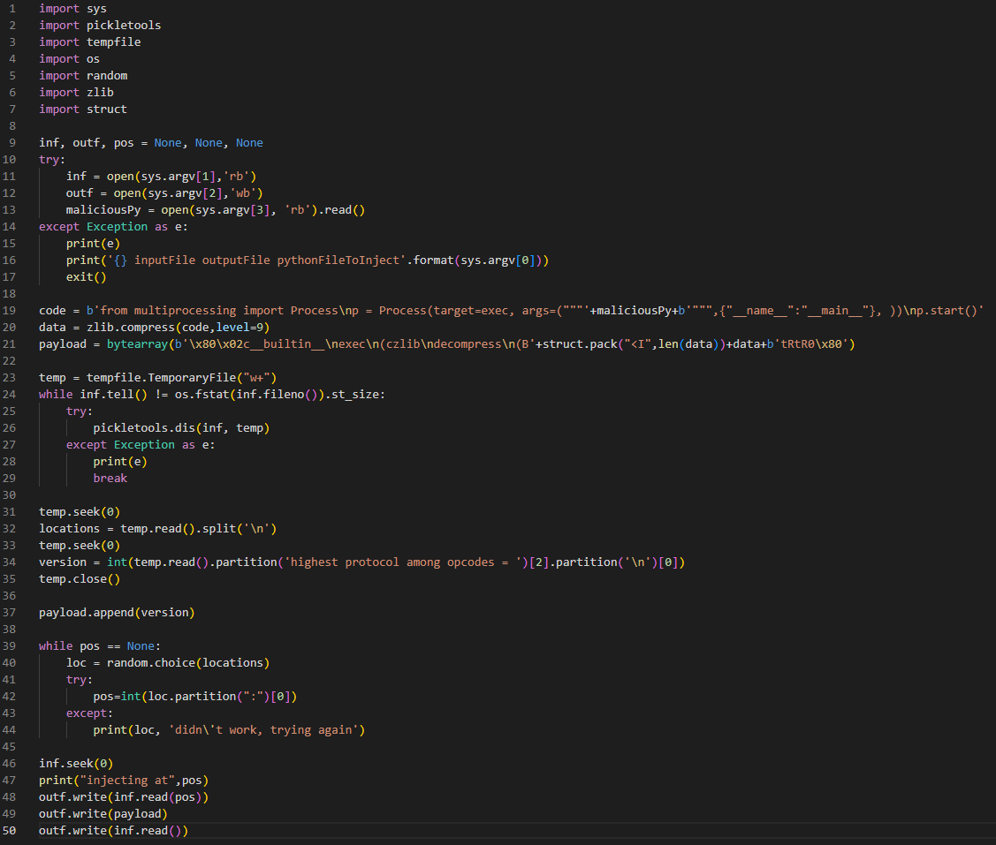
UNIVERSAL ATTACK
Requirements
Not obvious to the user or Intrusion Detection Systems
Parse pickles without loading them (don’t want to get attacked ourself)
Avoid symbolic interpretation
Inject into an arbitrary location of the Pickle

Slide 12
Universal Attack
Not obvious to the user or Intrusion Detection Systems
Spins off own thread
Size isn’t a concern because the model is often 100s of MB
Zlib compress the injected python file so it’s not a giant base64 blob
Don’t launch MimiKatz and you should be fine

Slide 13
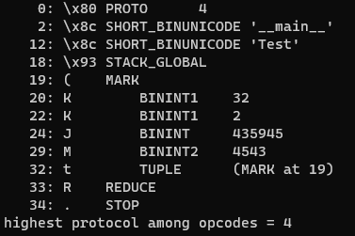
Universal Attack
Parse, but don’t load the Pickle
All we need to know is the boundary between instructions
pickletools.dis()’s output contains the offset into the pickle where the instruction starts
Our target location will be between two arbitrary instructions
Original pickle Up to random instruction
Evil instructions
Remainder of Original Pickle

Slide 14
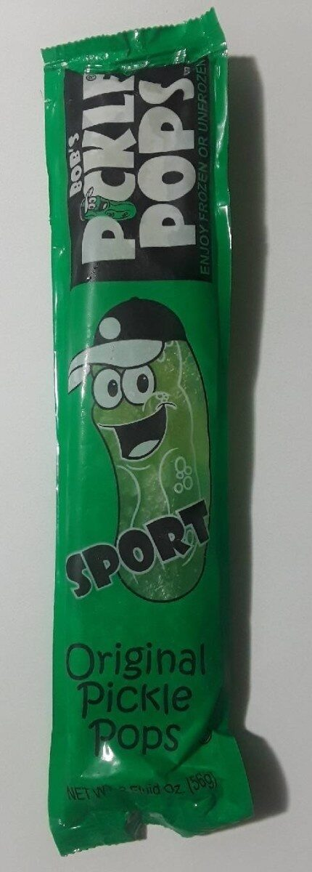
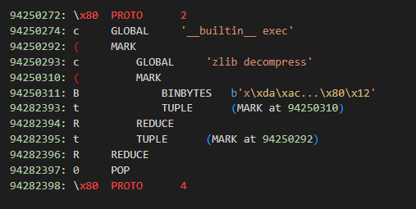
Universal Attack
Leave No Trace
Only use Pickle instructions that alter the stack
So long as the stack is the same before our code runs and after we can do anything
Pop is your best friend at cleanup time

Slide 15
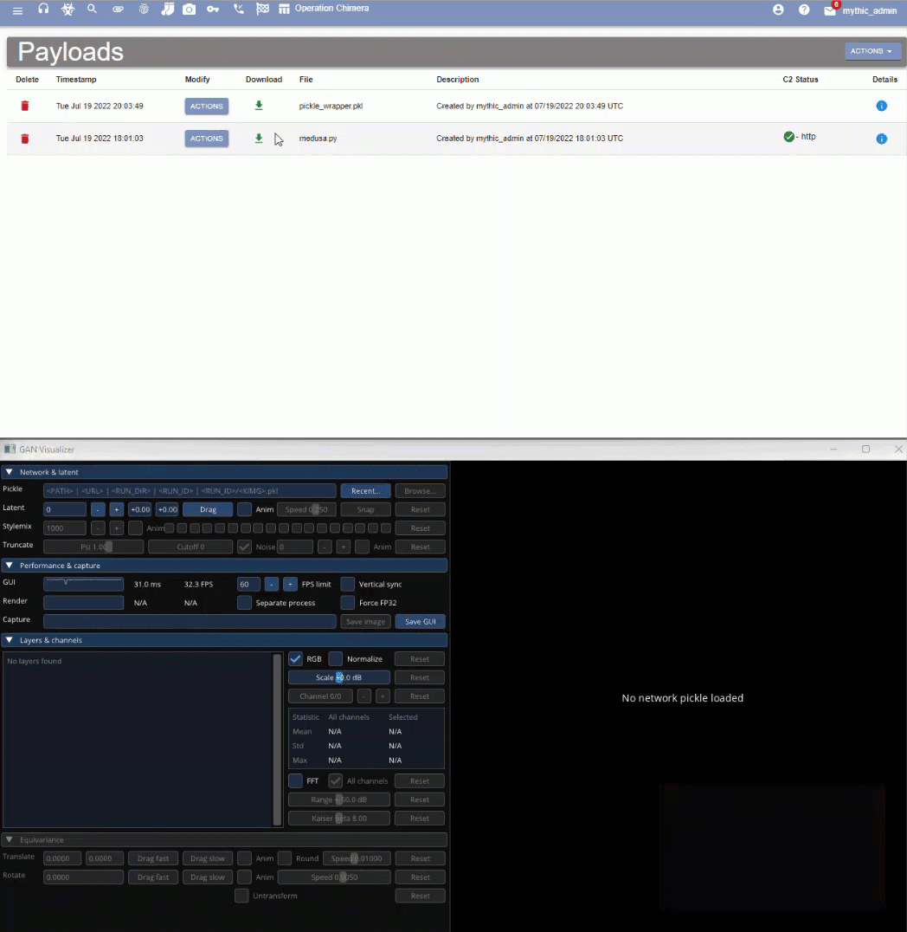
Real Life
How would this Play Out
1. Access and replace a unsigned executable pickle someone else will load (supply chain, watering hole, phishing)
2. Wait for callback
3. Pivot and profit

Slide 16
Real Life
How to detect a malicious pickle
Scan it like you would an executable
Antivirus software is hard because pickles are not a file type
Verify it is the same file as when it was created
Check an HMAC or hash assuming you have a 100% secure storage mechanism
Fickling is the closest to a true solution, but isn’t what they recommend either

Slide 17
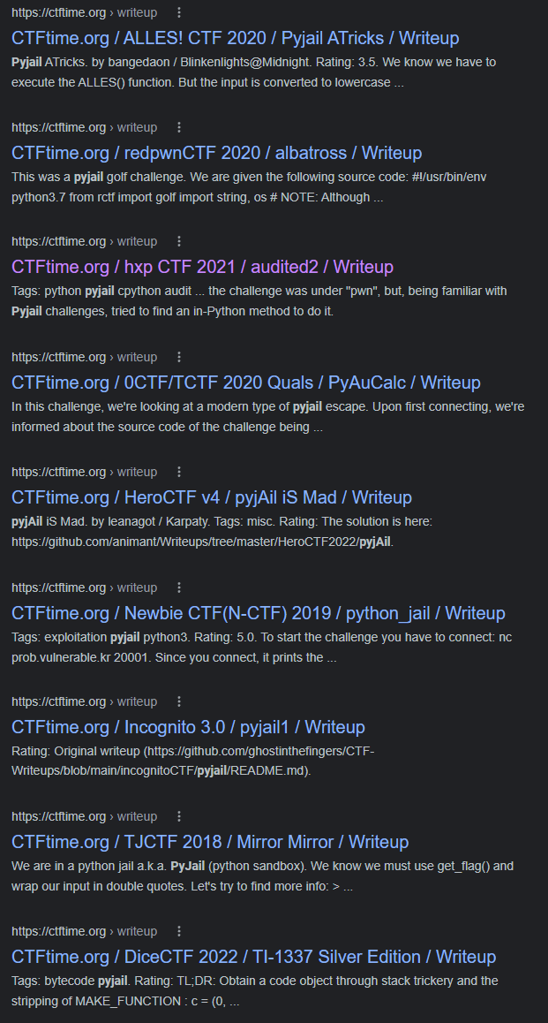
Real Life
How to safely load a Pickle of dubious origins
Don’t load them
“secure” methods involve knowing every function called
Even then, python jails are not something generally consider effective

Slide 18
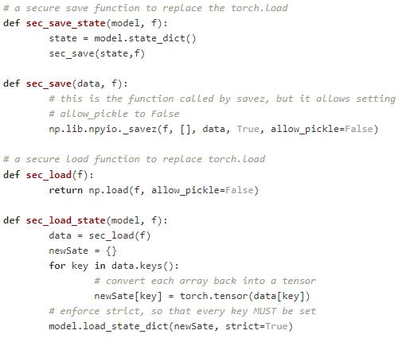
Real Life
creating something new
Release the layers as code or a signed executable
Release the weights as a binary blob
Irreplaceable existing pickles
protect them like unsigned executables
verify integrity
Only offer downloads over encrypted channels (HTTPS)
If an adversary ever gets access, delete and recreate
So what can we do today

Slide 19
Real Life
So ONNX and other formats are safe …
If it allows arbitrary layers, it is likely be vulnerable
For example, ONNX has an existing POC¹
ONNX and the rest could make great research projects
1. https://github.com/alkaet/LobotoMl/tree/main/ONNX_runtime_hacks

Slide 20
Code and Questions
Code Attack and defense code will be released at https://github.com/coldwaterq/pickle_injector
Mythic Pickle Wrapper A wrapper for the Mythic Medusa agent will be released at https://github.com/MythicAgents/pickle_wrapper
Questions If you have any questions, ask me in person or feel free to ask me on Twitter @ColdwaterQ

